Slide 1

Uber Supply-Demand Gap Analysis

Slide 2

AGENDA
Objective
Analyze Uber ride request data.
Identify patterns behind trip cancellations and no car availability.
Provide actionable insights to improve operations.
Tools Used
Excel: Data cleaning & dashboard.
SQL: Insight extraction from structured queries.
Python: Exploratory Data Analysis (EDA).

Slide 3
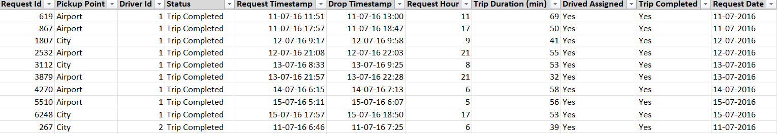
Dataset Overview
Data Info Total Rows: 6745 Time Period: July 2016 Pickup Points: Airport, City Key Columns: Request Timestamp, Status, Driver ID, Trip Duration Data Issues Missing values in drop timestamps Inconsistent trip completion statuses Required date-time formatting

Slide 4
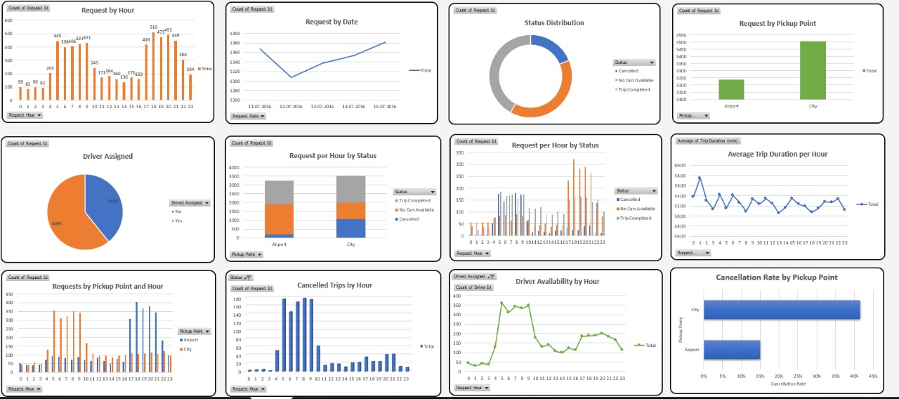
Excel Dashboard

Slide 5

Excel Insights
Insight 1:
Most requests come between 5 AM to 9 AM
Driver availability is low during this period.
Insight 2:
Airport has higher cancellation and unavailability issues
Insight 3:
Driver availability drops at night, correlating with 'No Cars Available'

Slide 6
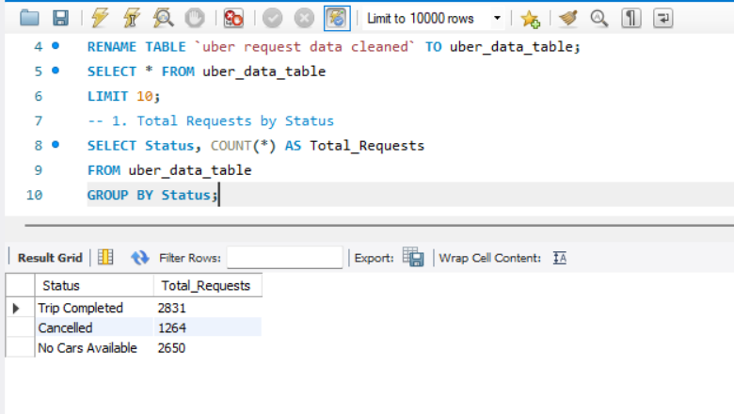
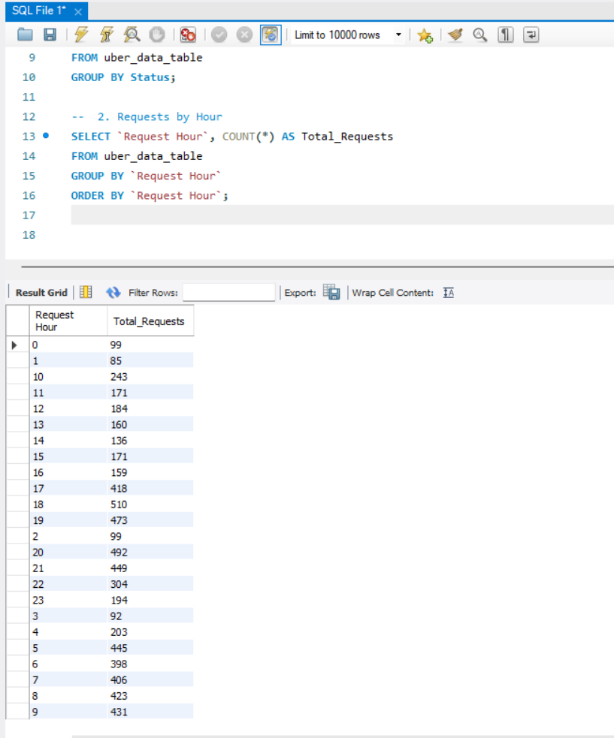
SQL INSIGHTS
Query 1- Total Requests by Status
Query 2- Requests by Hours

Slide 7
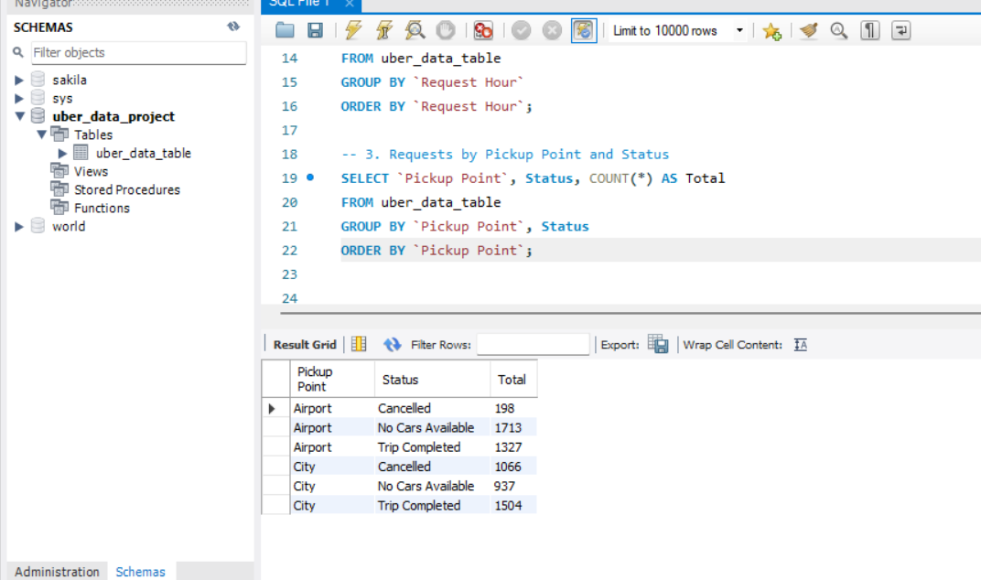
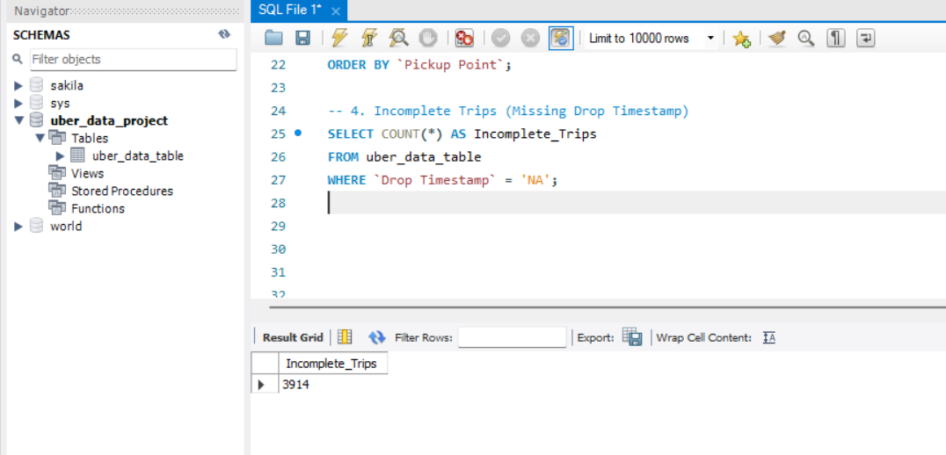
Query 3 - Request by Pickup Point & Status
Query 4 - Incomplete Trips (Missing Drop Timestamp)

Slide 8
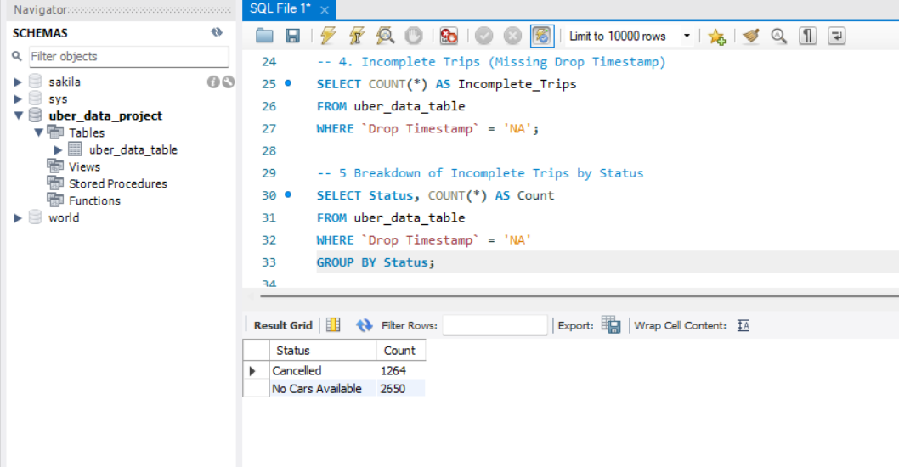
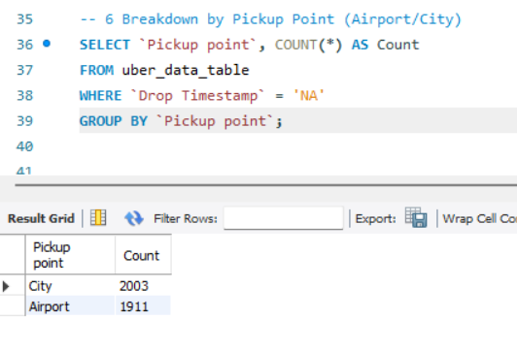
Query 5 - Incomplete Trips by Status
Query 6 - Incomplete Trips By Pickup Point

Slide 9
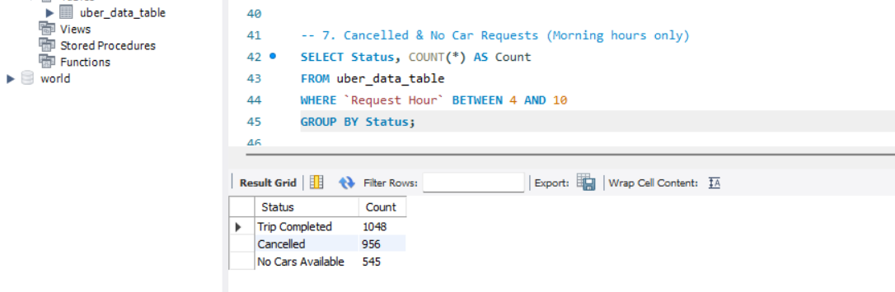
Query 7 – Trip Completed, Cancelled & N0 Car Available (Morning Hours Only)

Slide 10
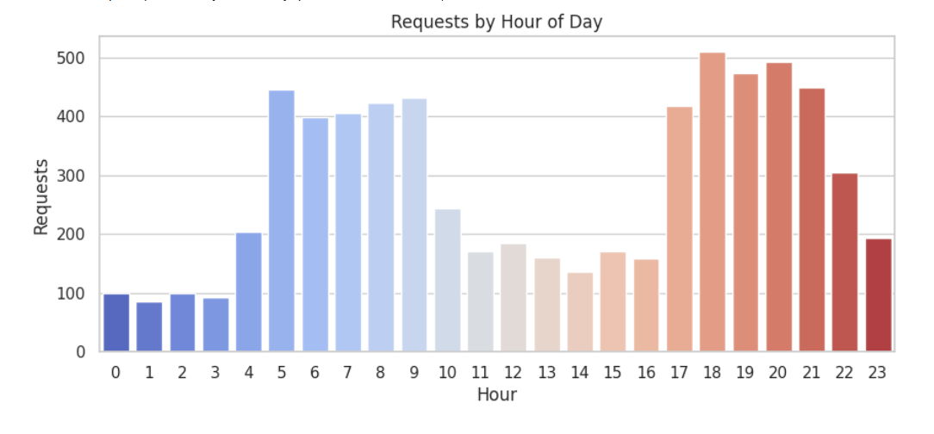
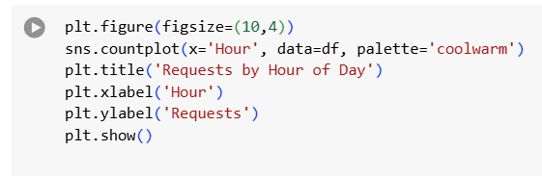
EDA HIGHLIGHTS

Slide 11
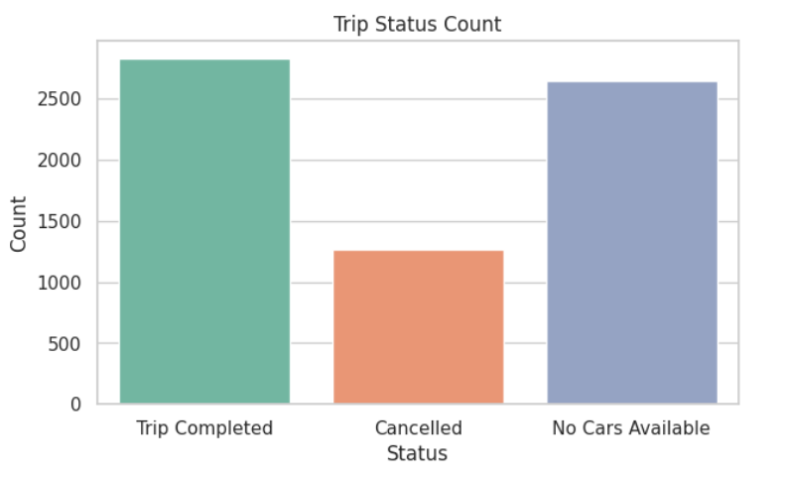
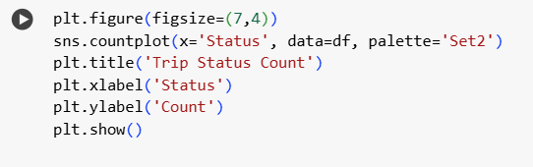

Slide 12
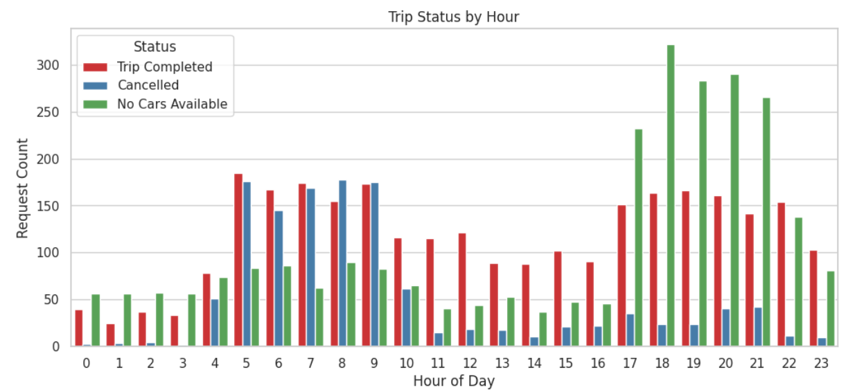
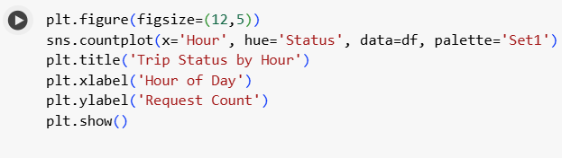

Slide 13
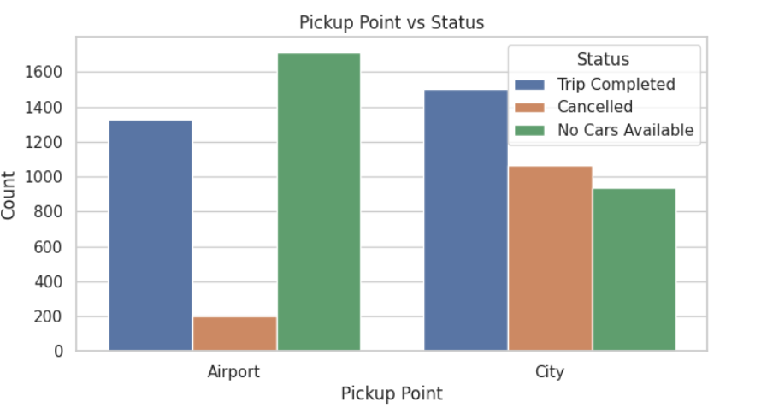
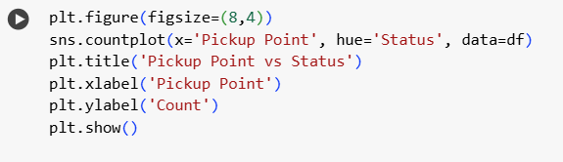

Slide 14
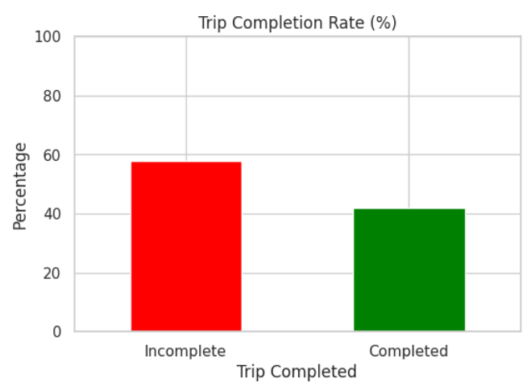
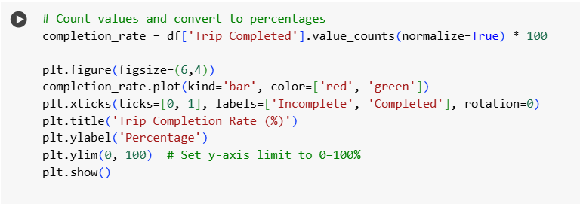

Slide 15
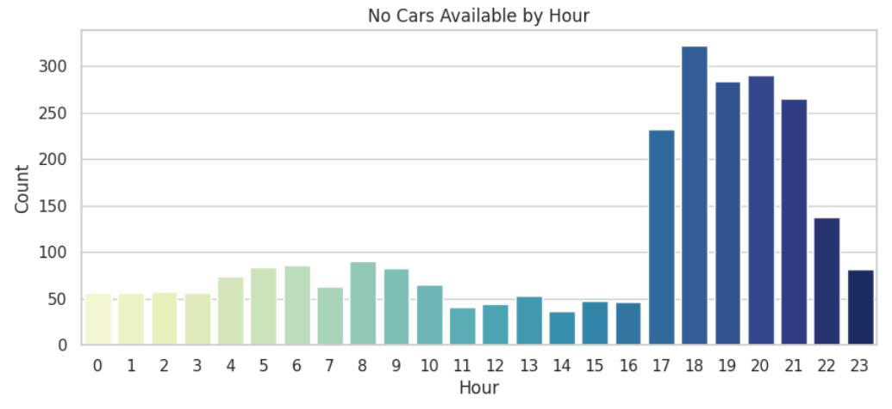
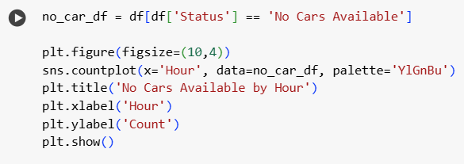

Slide 16
Recommendations
Rush Hour Incentives – Reward drivers for early morning pickups
Night Shifts – Deploy drivers from 10 PM–2 AM
Airport Allocation – Increase car availability at airport
Real-Time Monitoring – Use dashboards to detect live gaps

Slide 17

THANK YOU
Name: Himanshu
Role: Data Analyst Intern
hiimanshuu0406@gmail.com

